Slide 1

Mental Health (Depression)

Slide 2
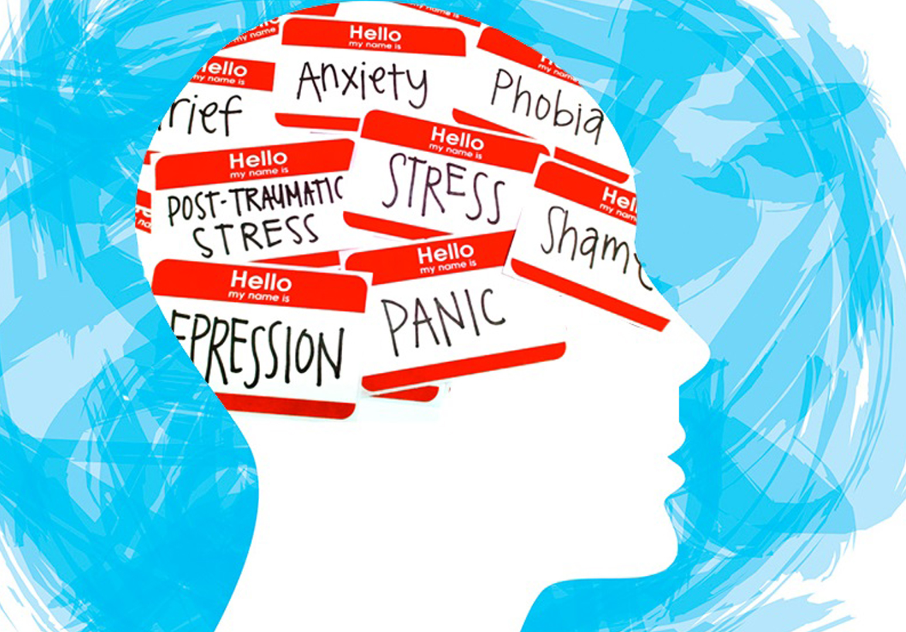
What is the problem?
Humans are people with emotions and thinking. In general, this is a good thing as it allows us to be passionate and even create tools and machinery to help with our everyday lives. But with all good things, there are downsides. In this case, it's Mental Health issues, specifically depression

Slide 3

WHO IS AFFECTED AND HOW
In general, each human has his/her own struggles as we are all different in one way or another. In a business sense, it would be the business owners , which is the focus for this project.
Mental health issues, such as depression, can affect business owners, not only because they might experience these challenges themselves but also because their employees might suffer from them, which in turn can impact the company's revenue.
As business owners, they provide services or sell products to customers, who are also human beings and may experience mental health issues, which can influence their purchasing behavior.

Slide 4
WHAT IS THE VALUE IN SOLVING THE PROBLEM? WHY SOLVING IT MATTERS?
Improved Employee Well-being
Enhanced Productivity
Positive Company Culture
Customer Relations
Reputation and Brand Image
Economic Impact

Slide 5

Improved Employee Well-being
By solving the problem of mental health issues among employees, business owners can foster a healthier and more supportive work environment.
This can lead to increased job satisfaction, reduced absenteeism, and lower turnover rates, all of which contribute to a more stable and productive workforce.

Slide 6

Enhanced Productivity
When employees are mentally healthy, they are more likely to be engaged, focused, and efficient in their roles.
This directly translates to higher productivity levels, which can positively impact the overall performance and revenue of the company.

Slide 7

Positive Company Culture
Prioritizing mental health helps in creating a positive and inclusive company culture.
This can enhance team cohesion, morale, and loyalty among employees, making the organization a more attractive place to work and reducing recruitment costs.

Slide 8

Customer Relations
Business owners who address mental health issues can better relate to their customers, who may also face similar challenges.
Understanding and empathizing with customers' mental health can improve customer service and build stronger relationships, potentially increasing customer satisfaction and loyalty.

Slide 9
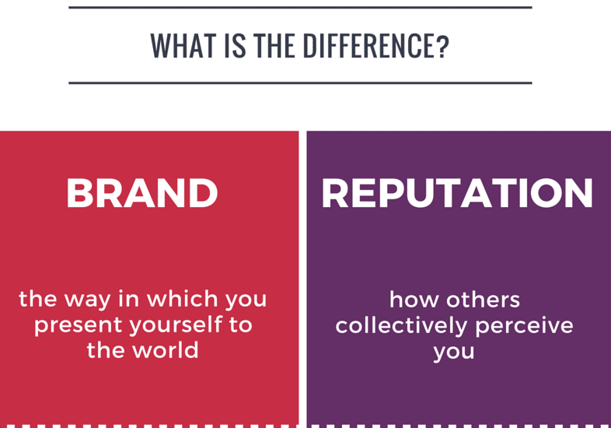
Reputation and Brand Image
Companies that actively support mental health initiatives can enhance their reputation and brand image.
Being seen as a socially responsible and caring organization can attract positive attention from customers, investors, and the broader community.

Slide 10

Economic Impact
Solving mental health problems can have a broader economic impact.
By improving the mental health of employees, businesses can contribute to reducing the overall economic burden associated with mental health issues, such as healthcare costs and lost productivity.

Slide 11
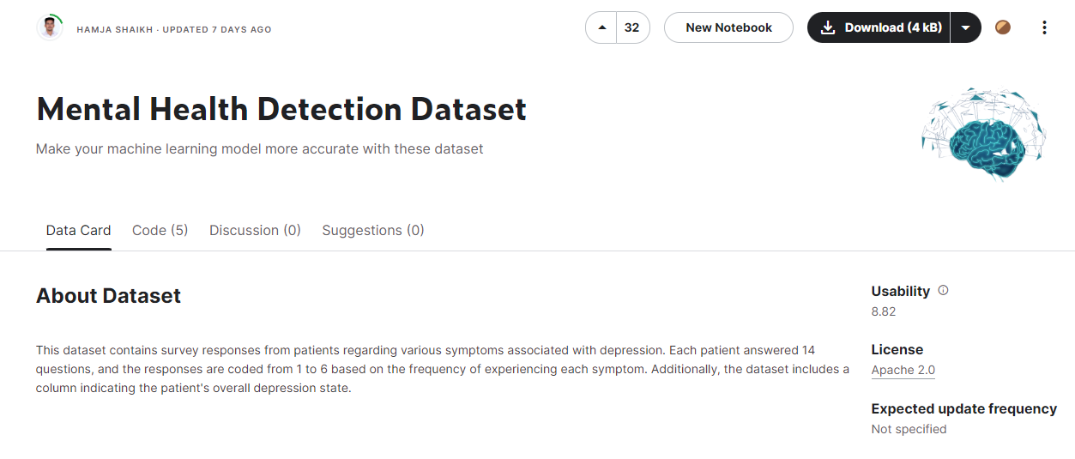
Chosen dataset
Mental Health Detection Dataset

Slide 12
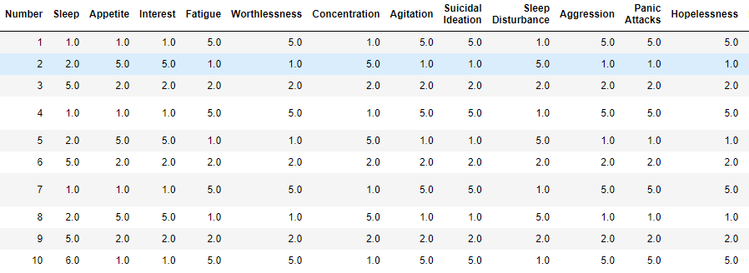
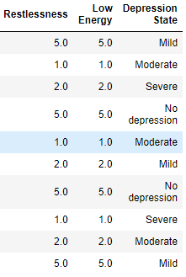
UNDERSTANDING THE DATASET
1: Never
2: Always
3: Often
4: Rarely
5:Sometimes
6: Not at all
0: No depression
1: Mild
2: Moderate
3: Severe
The following columns represent some features affect the chosen target variable, in this case, it is 'Depression State'. In this dataset, 'Sleep' refers to Sleep Disturbances. 'Interest' refers to loss of interest.
(After implementing 'mapping'.)

Slide 13
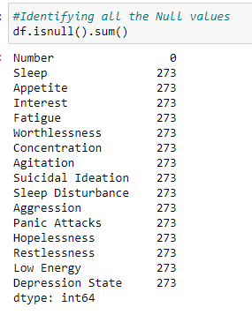
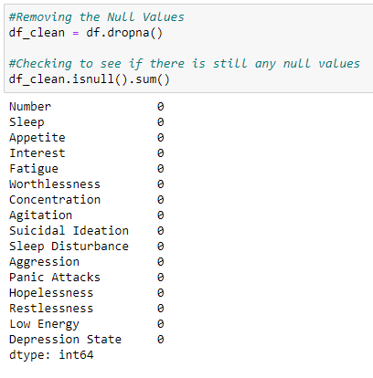
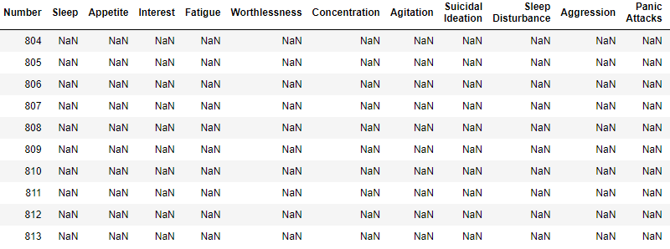
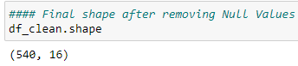
Cleaning THE DATASET
After checking the dataset, there was an unidentified amount of null values/empty columns & rows.
After checking, I had determined there was about 273 rows that had null values. These rows were henceforth removed. The final shape of the dataset is 540 rows
and 16 columns

Slide 14
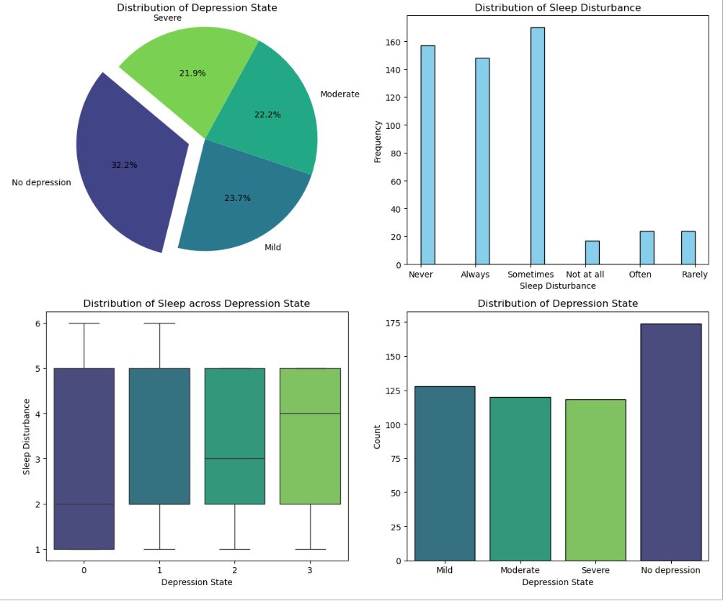
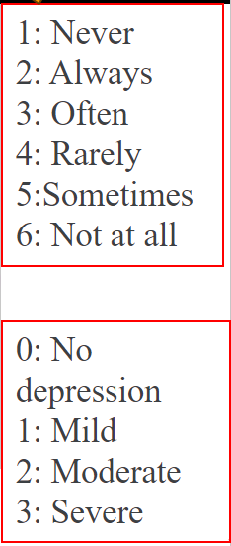
Visualising the datASEt
According to the pie chart, only 1 out of 3 people do not have depression
Histogram of 'Sleep Disturbance' column
Same as the pie chart but in bar chart form
(The numbers and what they signify)

Slide 15
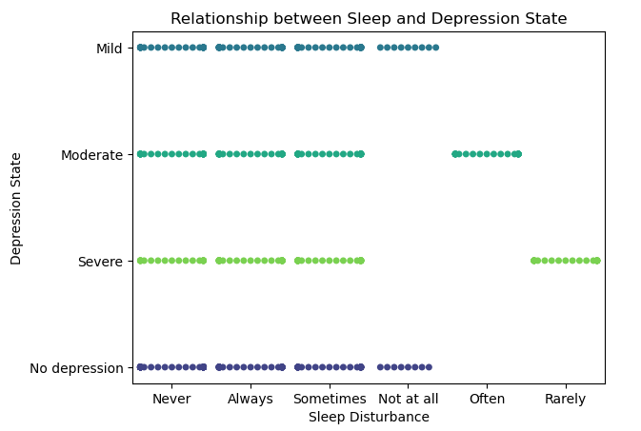
VISUALISING THE DATASET
A swarm plot with only 37.5% of the data due to having a large pool of data.
To show the frequency for each column and row.

Slide 16
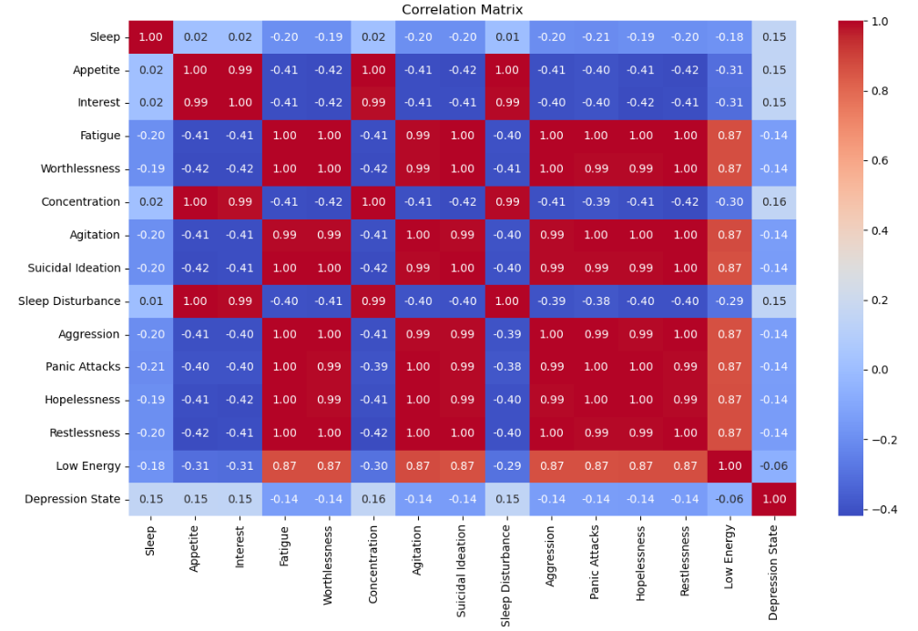
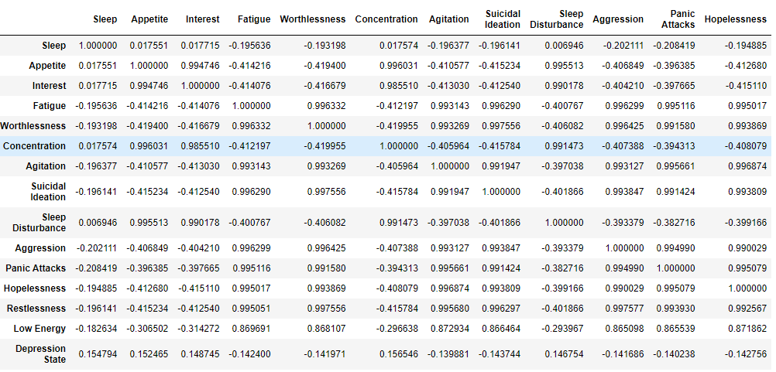
Correlation
Correlation Heatmap
Darker Red = Higher correlation.
Darker Blue = Little to no correlation.
(what am I looking at)

Slide 17
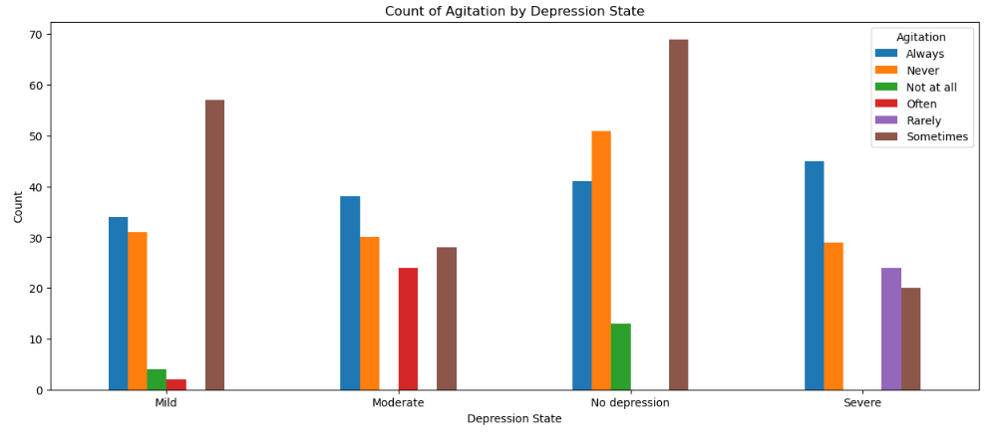
RELATIONSHIP BETWEEN 'dEPRESSION STATE' & OTHER FEATURES
(Feature can be inputted in the code located in Jupyter Notebook to infer relationship)

Slide 18
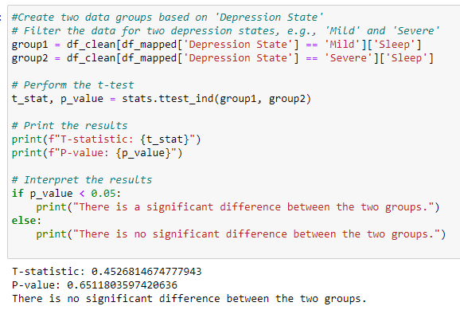
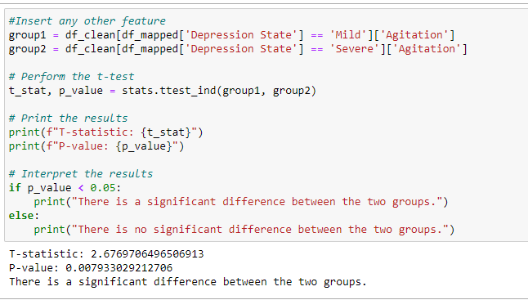
T-Test
After conducting a t-test to compare the sleep disturbance scores between individuals with 'Mild' and 'Severe' depression states. The sleep disturbance scores of the 'Mild' group were compared to those of the 'Severe' group to determine if there is a statistically significant difference between the two groups. The test helps us understand whether the difference in sleep disturbance between these two depression states is meaningful or if it could have occurred by chance."
There is a significant difference in Agitation.
This means people with severe depression feel much more agitated than those with mild depression

Slide 19
RECOMMENDED SOLUTIONS
Promote Mental Health Awareness
Implement Supportive Policies
Training and Education: Provide training sessions for employees and management to raise awareness about mental health issues, their signs, and how to seek help.
Open Dialogue: Encourage open conversations about mental health to reduce stigma and create an inclusive environment where employees feel comfortable discussing their challenges.
Mental Health Days: Allow employees to take mental health days as part of their sick leave to rest and recuperate.
Flexible Work Arrangements: Offer flexible working hours or remote work options to help employees manage stress and maintain a healthy work-life balance.

Slide 20
RECOMMENDED SOLUTIONS
Provide Access to Professional Help
Foster a Supportive Work Environment
Employee Assistance Programs (EAPs): Offer EAPs that provide confidential counseling services, support groups, and resources for employees struggling with mental health issues.
Health Benefits: Ensure that health insurance plans cover mental health services, including therapy and medication.
Wellness Programs: Develop wellness programs that include activities such as yoga, meditation, and exercise to promote physical and mental well-being.
Stress Management: Offer workshops on stress management techniques, time management, and resilience building.

Slide 21
RECOMMENDED SOLUTIONS
Regular Check-ins and Feedback
Create a Positive Work Culture
Surveys and Assessments: Conduct regular surveys to gauge employee mental health and identify areas for improvement. Use this data to inform policies and initiatives.
One-on-One Meetings: Managers should have regular check-ins with their team members to discuss their well-being and offer support.
Recognition and Rewards: Acknowledge and reward employees' hard work and achievements to boost morale and motivation.
Team Building: Organize team-building activities to strengthen relationships and create a sense of community and support among employees.

Slide 22
RECOMMENDED SOLUTIONS
Leadership Commitment
company outings
Lead by Example: Leaders should model healthy behaviors and demonstrate a commitment to mental health by participating in wellness initiatives and openly discussing the importance of mental well-being.
Policy Enforcement: Ensure that all mental health policies are consistently enforced and that any signs of discrimination or stigma are promptly addressed.
Enhancing Creativity and Innovation: Informal settings can encourage creative thinking and the sharing of new ideas that might not emerge in a more formal work environment. Outings allow employees from different departments to interact and collaborate, potentially leading to innovative solutions and improved workflows.
Boosting Morale: Organizing outings can make employees feel valued and appreciated, boosting their morale and motivation. Regular social activities contribute to creating a positive and enjoyable work environment, which can improve job satisfaction and retention.

Slide 23

Limitations
There was about 273 rows of data missing.
Those missing data could have provided more insight as well as having a more accurate calculation.
The survey might be biased. For example, the survey might have been done in only Engineering fields.
The data might not account for other confounding variables affecting the Depression State.

Slide 24

Suggestion
The dataset did not have an open-ended question for other features that were not mentioned in the survey. At the end of the survey, there could have been a text box for applicants to fill in if some other feature was affecting them.
For example
Genetics
Trauma and Abuse
Substance Use
Chronic Illness or Disability
Cultural Factors
Medication

Slide 25

Assumptions made
Assumption in the person actually wants to get better.
Is passionate about his/her work.
Put in the effort.
Depression might be incurable but it is treatable.

Slide 26
Q&A SESSION

Slide 27

THANK YOU!

